Slide 1
NAACL 2013 Report
Fei Liu, Bingqing Wang
July 2, 2013

Slide 2
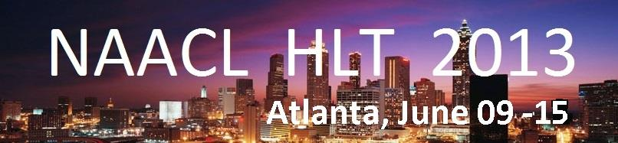
Logistics
Tutorials: June 09
Main Conference: June 10 – 12
Workshops: June 13 – 15
Joint NAACL/ICML Symposium: June 15
Location
Westin Peachtree Hotel, Atlanta, Georgia

Slide 3
Sessions
Parsing
Machine Translation
Semantics
Topic Model
Information Extraction
Social Media Text
Spoken Language
TACL

Slide 4
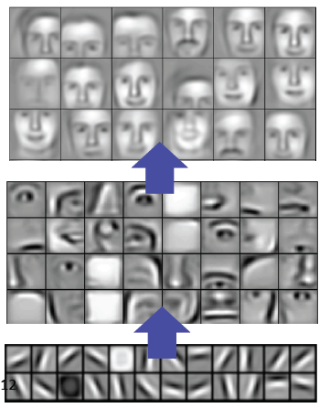
Tutorials (1/2)
Deep Learning for NLP
Richard Socher and Chris Manning, Stanford
Take-home message
Learning multiple levels of latent representations
Unsupervised pre-training is a key factor

Slide 5
Tutorials (2/2)
Spectral Learning Algorithms for NLP
Cohen, Collins, Stratos, Columbia
Foster, Ungar, UPenn
Take-home message
Use CCA (canonical correlation analysis) to learn low dimensional representation
Learned word representations maximize the correlation between contrasting views

Slide 6
Papers (1/6)
Relation Extraction with Matrix Factorization and Universal Schemas
Riedel, UCL, Yao, McCallum, Marlin, Umass
Take-home message
Universal schema: union of surface form predicates as in OpenIE and relations in the schemas of pre-existing databases
Learn latent vectors for entity tuples and relations, used to populate the database

Slide 7
Papers (2/6)
Learning a Part-of-Speech Tagger From Two Hours of Annotation
Dan Garrette, Jason Baldridge, UT Austin
I am hopeful that Garrette and Baldridge’s approach will encourage NLP researchers to write more papers that fall into the category “Look Mom! I improved the state-of-the-art with only $250 of investment in data annotation” and fewer papers that fall into the category “Look Mom! I spent three years of my life and no money on data annotation, but I got a system that is 53% below the state of the art.”
-- Daniel Marcu

Slide 8
Papers (3/6)
PPDB: The Paraphrase Database
Juri Ganitkevitch, Benjamin Van Durme, JHU, Chris Callison-Burch, UPenn
Take-home message
Over 220 million paraphrase pairs
Capture meaning-preserving syntactic transformations

Slide 9
Papers (4/6)
Automatic Generation of English Respellings
Bradley Hauer, Grzegorz Kondrak, U Alberta
Take-home message
Best student paper
Map English spellings to pronunciations
E.g., “Huatulco” (Mexican resort)
→ “wah-tool-koh”

Slide 10
Papers (5/6)
Semantic Parsing Freebase: Towards Open-domain Semantic parsing
Qingqing Cai and Alexander Yates
Take home message
A similar work has been accepted by ACL 2013
First-order logic for the question semantic parsing
The dataset come from Freebase, and tried some domain-transfer method for different domains in Freebase

Slide 11
Papers (6/6)
Named Entity Recognition with Bilingual Constraints
Wanxiang Che, Mengqiu Wang, Chris Manning and Ting Liu
Take home Message
ILP is used in the inference phrase to put some constraint
Use the bilingual sentence as the constraint

Slide 12
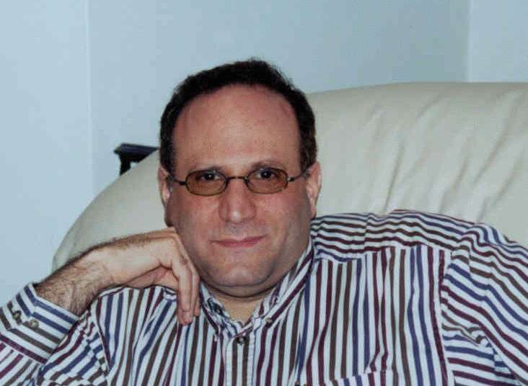
Symposium (1/3)
Learning to Say What You See and See What You Say
Jeff Siskind, Purdue
Video In Sentence Out
Demo Video

Slide 13
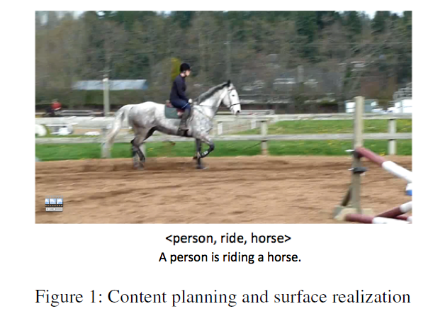
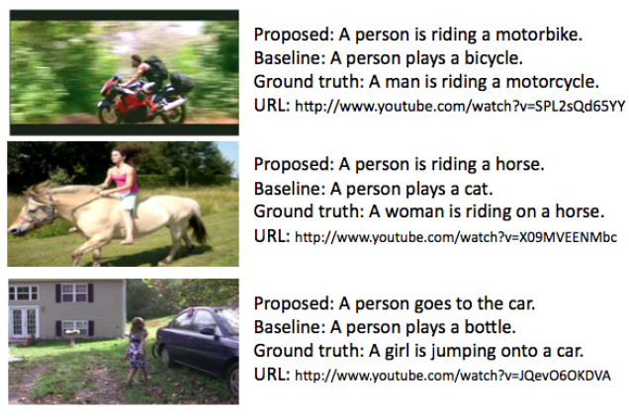
Symposium (2/3)
Generating Natural-Language Video Descriptions Using Text-Mined Knowledge
Ray Mooney, UT Austin

Slide 14
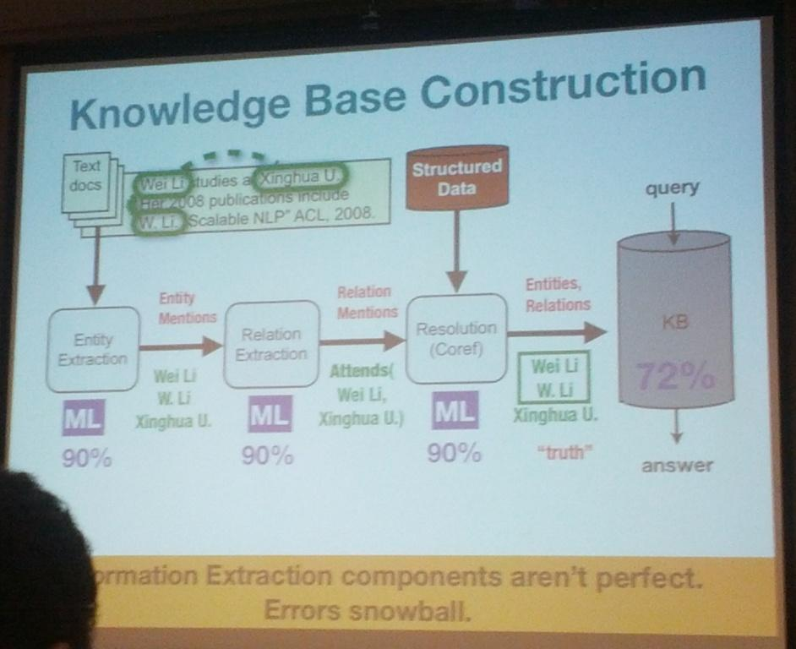
Symposium (3/3)
Parallel, Distributed and Sparse Computation for Automated Knowledge Base Construction
Andrew McCallum
UMass

Slide 15
Workshop
*Sem
Task: Semantic Textual Similarity
calculate the similarity between given sentence pair
SemEval
Task
TempEval
Sentiment Analysis in Twitter
Spatial Role Labeling
Cross-lingual Word Sense Disambiguation

Slide 16
Workshop
Resource
Babelnet
http://lcl.uniroma1.it/babelnet/
Wordnet+wikipedia+Dbpedia+wikitionary+multilanguage

Slide 17
Thank You!

